Slide 1
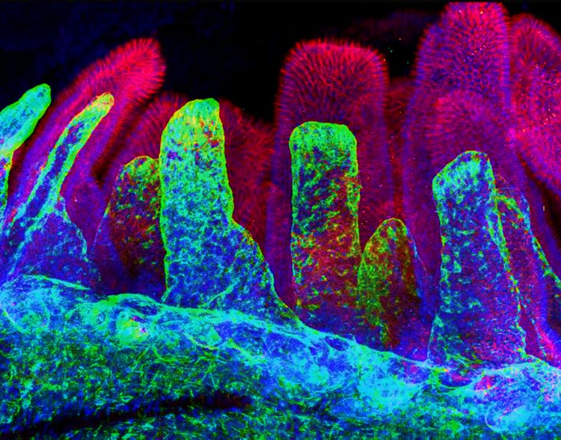
Deep Learning based approaches for Investigating Signaling Dynamics in Intestinal Stem Cells (ISCs)
https://github.com/YashBorikar/deep-learning-signaling-dynamics-ISCs
Yash Borikar
220624059
May 18, 2023
Image Credit: https://irm.med.upenn.edu/study-published-on-the-intestinal-stem-cell-niche

Slide 2
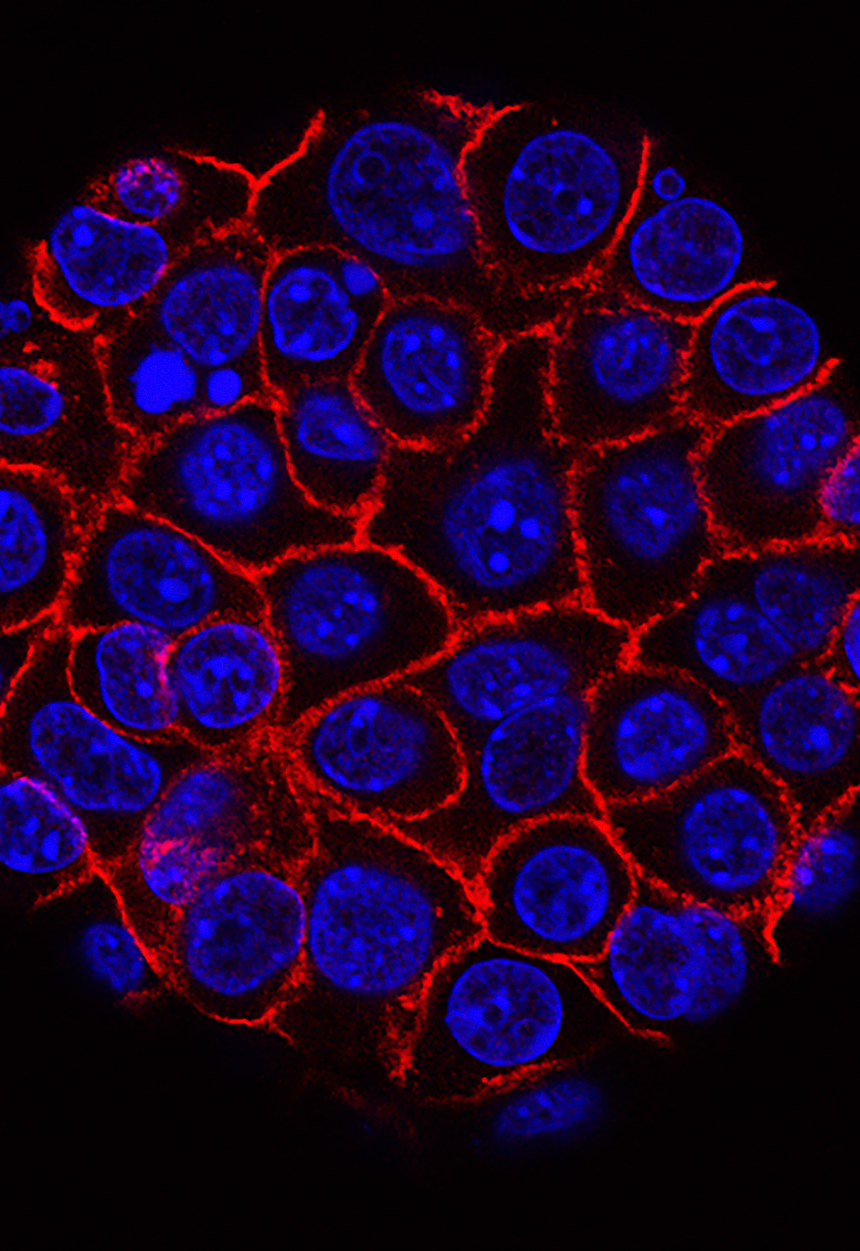
Proposals
Literatures Review
Studying the Image Informatics module (CSC8628)
Understanding the subject of Signaling Dynamics in Intestinal Stem Cells (ISCs)
Establishing a Git Repository
Acquiring knowledge on how to use Overleaf (LaTeX)

Slide 3
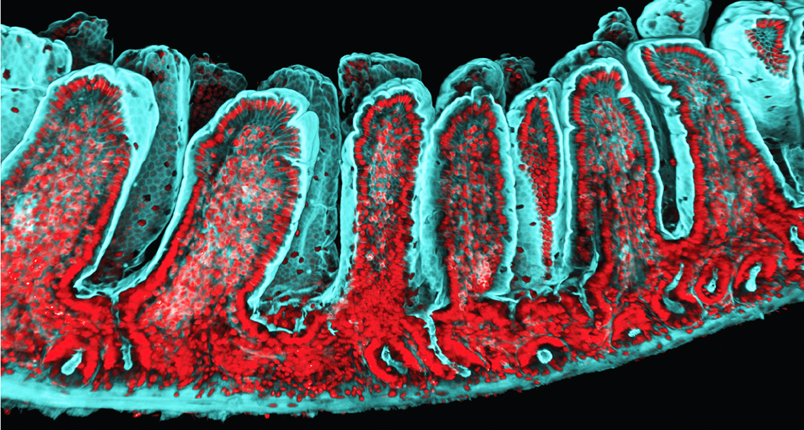
Accomplishments
Image Source: https://www.science.org/doi/10.1126/science.abb6848

Slide 4
Accomplishments
SECTION 1 TITLE
SECTION 2 TITLE

Slide 5
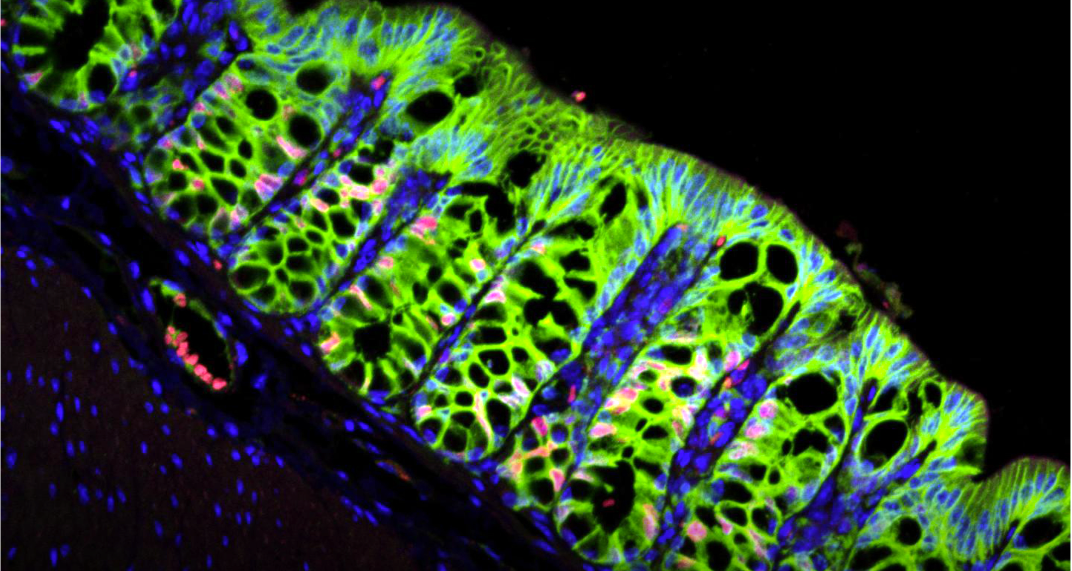
Goals
Literatures Review
Understanding the subject of Signaling Dynamics in Intestinal Stem Cells (ISCs)
Starting to write an Interim report
Starting to write the dissertation report
Image Credit: https://www.genengnews.com/topics/translational-medicine/colon-stem-cells-rely-on-this-repair-signal-but-it-can-go-awry

Slide 6

TIMELINE
19th May 2023
Ethical Approval
09th June 2023
Interim Report
08th August 2023
Poster
14th August 2023
Dissertation
15th August 2023
Oral Presentation
STAGE
4
STAGE
5
STAGE
1
STAGE
3
Current Stage
STAGE
2
Completed

Slide 7
Planning
JAN
FEB
MAR
APR
MAY
JUN
JUL
AUG
SEP
OCT
NOV
DES
Meetings
Stakeholder discussions
Documentation
Design database
Software design
Interface design
Specification
Integeration
Initial testing
Testing
Demonstration
Finishing
CURRENT PROGRESS

Slide 8

THANK YOU!
Yash Borikar
220624059
Image Credit: https://www.raytheonintelligenceandspace.com/what-we-do/advanced-tech/synthetic-biology

